Slide 1
Managerial Recommendations for a College Town Movie Theater
Social Media Analytics & Digital Marketing

Slide 2
Overview
Goal:
Analyze the data using a variety of techniques to segment the respondents that attend movies and what they value most about their movie theater experience
Use this information to capitalize on the current customer base and increase the number of university students who attend movies, how many movies they attend, and how much they spend while at the movies

Slide 3
Cleaning and Developing the Data
First, the data is restructured with more meaningful descriptions and poor data is removed
I.e. Q5a renamed to ‘Arcade’
I.e. those who responded ‘7’ to questions with bounds from 1 to 4 were discarded
A new variable is created to provide important insight relevant to the success of the theatre - Monthly Revenue Generated per Customer:
By converting Question 4 – Extra Food Spend to average dollar amounts, the survey reveals, on average, customers spend an additional $4.41 while at the movies, with a standard deviation of $4.34
Assuming that the average movie ticket costs $15, the average total revenue generated per customer is $31.50, with a median of $18.80 and standard deviation of $29.90. Since there were outliers, the median of $18.80 provides a better description of the consumer market

Slide 4
Levels of Control of Different Offerings
Next, the survey responses in Question 5, 7 and 8 were analyzed for the ease in adjusting if needed
Highly dependent on the current layout and processes of the theatre
The services which require little to no CapEx should be targeted first

Slide 5
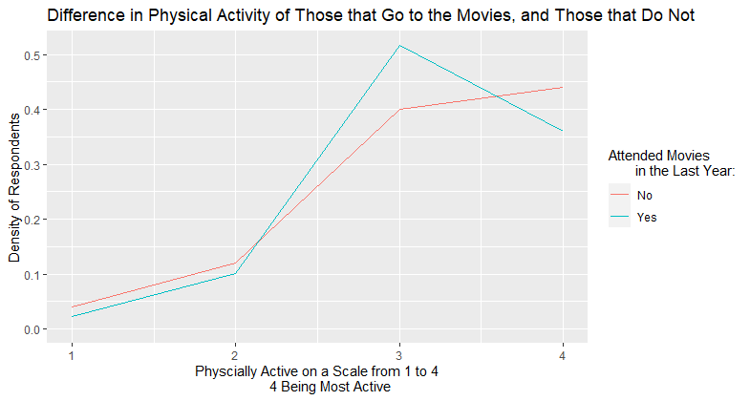
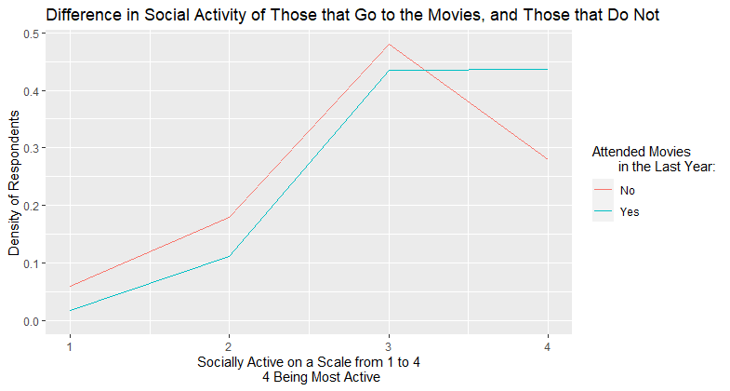
Key Demographic Metrics
Physical Activity, Social Activity, Gender, Ethnicity, University Year, and Age were all tested for correlation against Revenue per Customer per Month
The only relevant metrics were University Year and Ethnicity, however, a marketing plan would be more conducive with a sole focus on University Year

Slide 6
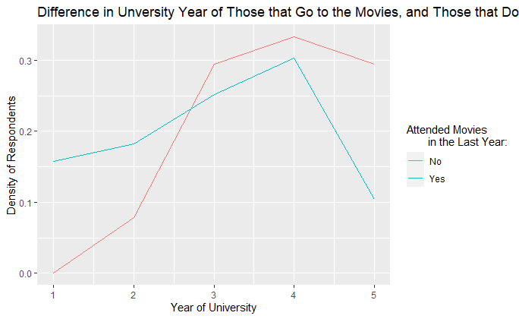
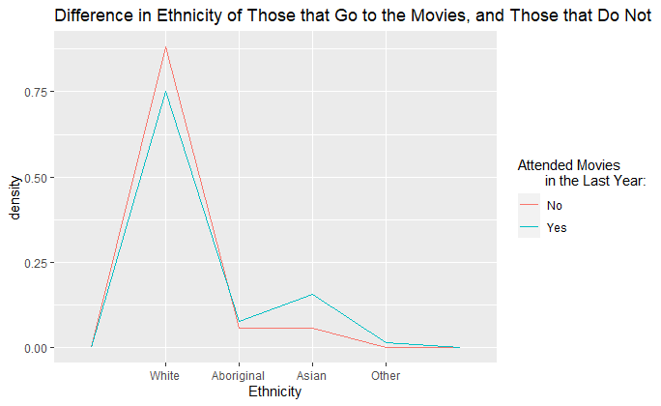
Key Demographic Metrics
Serve this gap

Slide 7
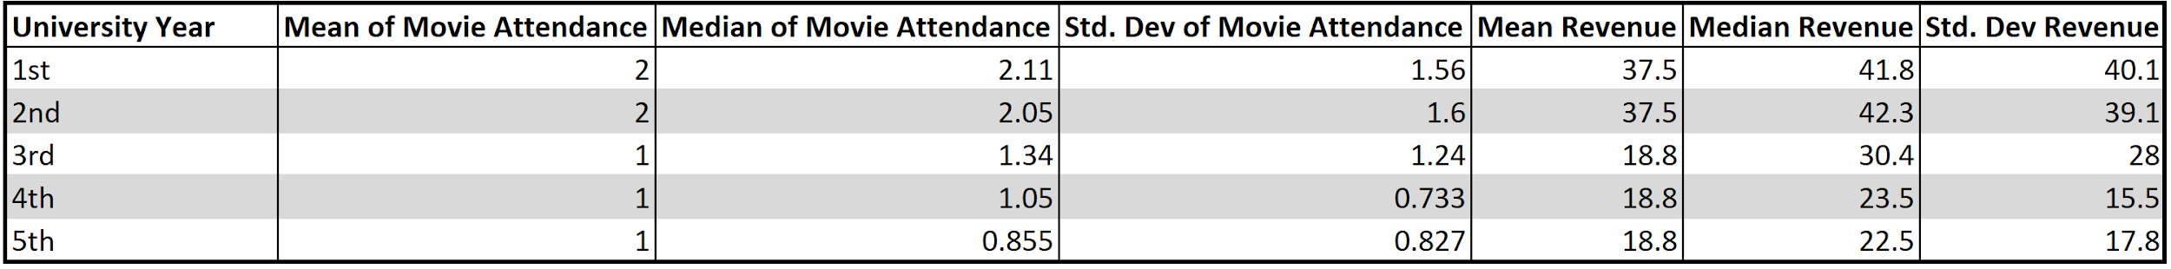
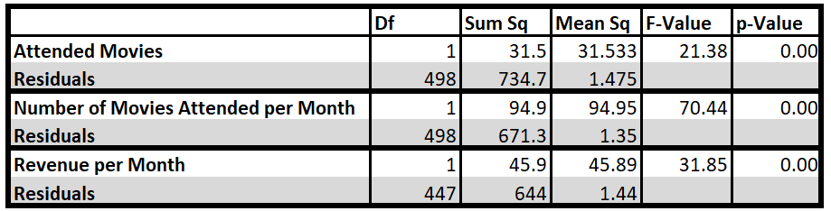
University Year is a Strong Indicator
There is a strong indication that depending on what year a student is in, it will have an effect on their movie attendance and the amount of revenue that they generate
This is confirmed by an ANOVA
Generally, both the plot and ANOVA show that there is a significant difference between the mean revenue per customer of a lower year student and upper year
A lower year student tends to result in a higher attendance of movies and thus higher spending at the theater
ANOVA

Slide 8
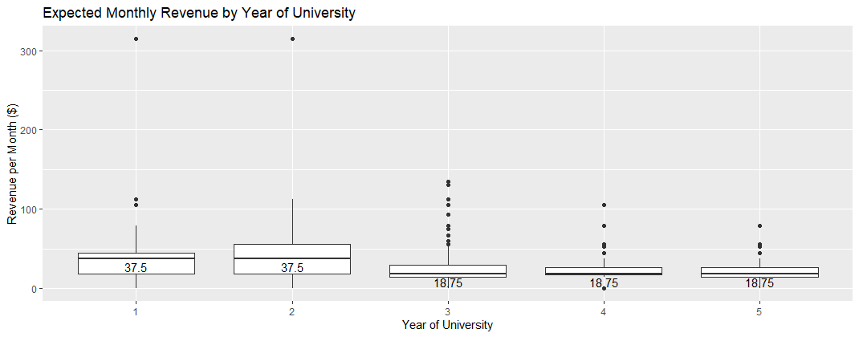
University Year is a Strong Indicator
Visualization of the higher spending by lower year students
Median difference of $18.75 per customer per month

Slide 9
Criteria for Recommendations – 3 Factors
Bias decision towards offerings that are relatively easy to control and are inexpensive
I.e. Clean restrooms are easier to control and cheaper vs. installing larger screens
If a certain customer brings in more revenue, their preferences are more important than a lower spending customer
Lower year students are the ideal target market because they have spending compared to upper year students and will be residing in the university town longer than upper year students.
By improving the experience for lower year students, this will translate into having them return to the theater as they get older

Slide 10
Important Findings
Services and Items
Arcade, food and drink, comfortable chairs and clean restrooms are relatively easier and cheaper to control
The majority of respondents value comfortable chairs, sound quality, clean restrooms, size of screen, and auditorium type chairs
Lower year students who spend more, place importance on food & drink, comfortable chairs, auditorium type chairs, and size of screen
Information Sources
Newspaper, internet and phone are relatively easier to focus on and are cheaper to control
Majority of respondents value being informed via the internet and through friends & family
Lower year students who spend more, value internet and phone advertising more than average
Purchasing Tickets
The only factor that can be influenced and is inexpensive, is how people purchase over the internet
In general, people prefer to purchase at the theatre
Lower year students who spend more prefer purchasing at the theatre, however, a growing number are using the internet

Slide 11
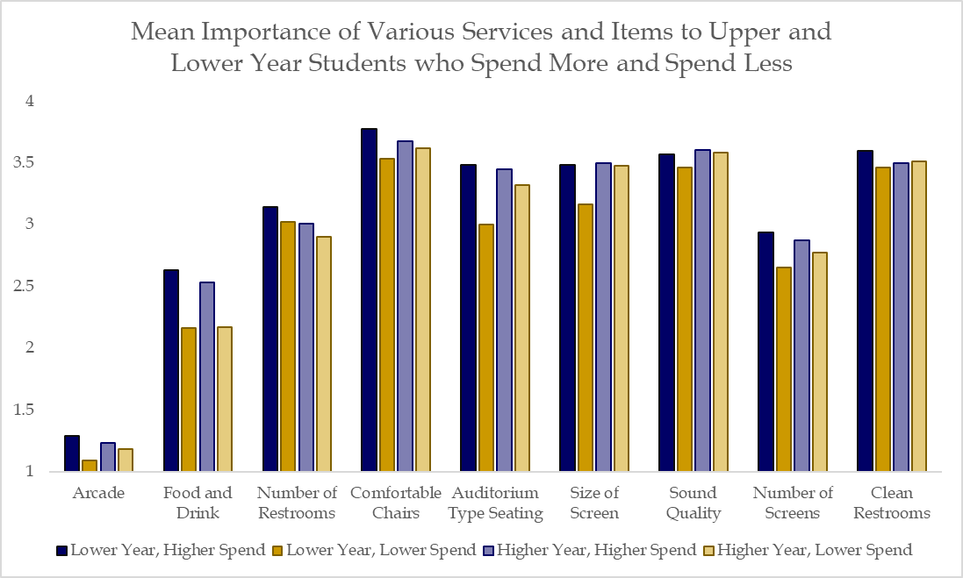
Important Findings - Services and Items
ANOVA:

Slide 12
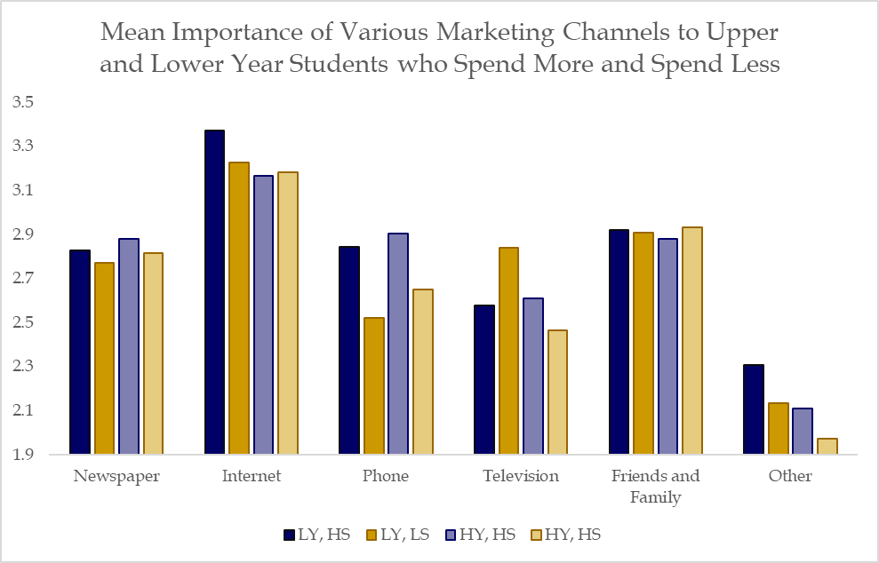
Important Findings - Information Sources
ANOVA

Slide 13
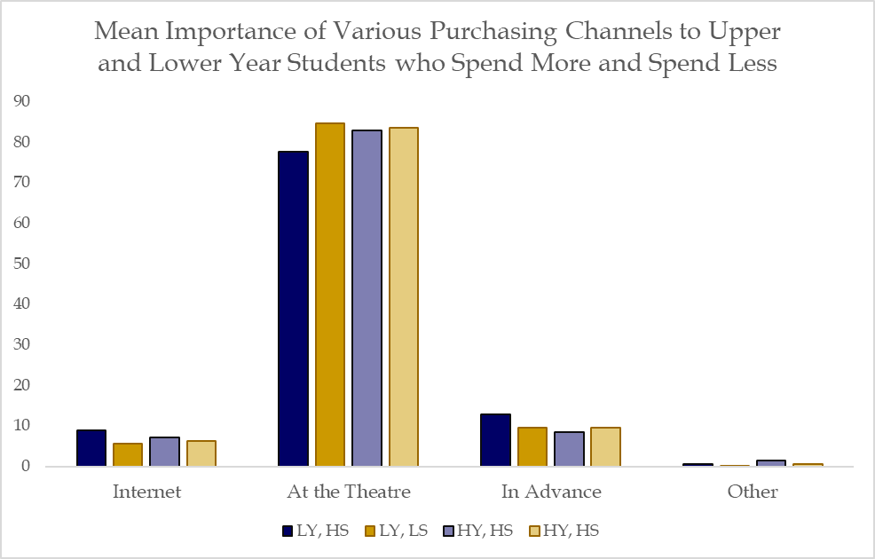
Important Findings - Purchasing Tickets

Slide 14
Recommendations - Services
The most valuable investments will be in comfortable chairs and clean restrooms
This is relatively easy to fund with limited capital expenditures and is something that the theatre can control
These investments will not only help in improving movie attendance, but will also make lower year students want to return as they progress through university, thus driving up revenue in the long-term
While food & drink is important to those who spend more, majority of people tend to be less concerned with high quality food and more concerned about simply having food to snack on
Auditorium style seating and the size of screen are both important to the general population and important to lower year students who spend more, but controlling these services would cost more than ensuring comfortable chairs. This can be altered in the long-term

Slide 15
Recommendations – Information Source and Purchasing Method
Investments should be made to improve internet advertisements, the movie theatre website, and a mobile phone app
From a marketing perspective, phone advertisements are most important to the higher spending respondents, while internet advertisements are most effective with the general population
In general respondents prefer to purchase their tickets at the theatre, however, demographics are shifting towards placing preference on the internet as lower years age
By improving internet advertisement and the movie theater website, a greater number of people will be informed of the services that the theater offers thus amplifying reach
Lastly, developing a mobile phone app would be highly effective in increasing the number of lower year students that attend movies, as they prefer to use their phones
A mobile app also remains on the user’s device for extended periods of time, which will act as a reminder as the lower year students become upper year students!

Slide 16
Recommendations - Loyalty Program
To provide incentive for lower year students to continue returning to the theater, a loyalty program should be implemented
This program will allow people to collect points (movie credits) via an app on their mobile devices
For every four movies that students attend, the fifth movie is 50% off
This encourages people to attend more movies than they currently do
It will also encourage groups of people to come together, as everyone will want to collect points
Additionally, while the fifth movie is discounted, the money that people save on movie tickets will allow them to spend more on food & drinks
Lastly, people will also earn points by purchasing food & drinks
Once enough points have been collected, students receive credit for a free medium popcorn
This will increase the amount that people spend while at the movies

Slide 17
Risks & Mitigations
Renovations to improve the seating will prevent the theater from showing movies during the renovation period
Historical data can be analyzed to determine what time of year has the lowest attendance, so construction can take place during this period
This will also be an opportunity to market a “Re-Opening” which will excite people and draw in many new customers
By focusing on lower year students, upper year students may be less inclined to come to movies
While the focus is on lower year students, things that upper year students value are still implemented
The goal is to retain the current lower year students as the get older, so upper year attendance will increase over the next 2-3 years
If the assumption that the average movie ticket of $15 is incorrect, this may affect the model that was built
This is a flexible model that can be adjusted by changing the average ticket price
The results will show similar trends even if the values differ slightly

